Slide 1
Data Science
a Digital Transformation enabler
Yann Gouedo
Data Scientist Leader – Machine Learning / Artificial Intelligence
Marketing / Risk / Fraud / Maintenance
IBM Certified Senior Data Scientist & IBM Certified Senior Architect

Slide 2
Clients expect more, and today’s enterprises must respond to compete
76%
70%
80%
of consumers expect companies to understand their needs and expectations
of customers say understanding how they use products and services is very important to winning their business.
of ‘leaders’ (vs challengers) report they’re very effective at uncovering new or unmet customer needs using data
Sources: Salesforce, State of the connected customer report; IBM Global C-Suite Study
Notes:
The digital economy is changing everything about business – and a new kind of competitive advantage has emerged: customer experience. Today’s digitally savvy consumers expect more engaging, personalized experiences, and their willing to look beyond their current brand to get them.
The businesses winning the battle are those that are transforming client experiences by turning the eruption of customer data being generated across digital, social, and mobile channels – into insights to create better, more personalized experiences for customers.
In fact, in the largest ever IBM Global C-suite study, the one factor, more than any other that distinguishes the market leaders – the “re-inventors” – from other organizations, is the capacity to use data to identify unmet customer needs. Eight out of 10 re-inventors report they’re very effective at uncovering new or unmet customer needs. And over one-quarter of re-inventors turn to artificial intelligence (AI) technologies and cognitive solutions to better understand customers and improve the customer experience.
But better data analytics is not enough, to be truly agile, enterprises must fundamentally rethink and transform their architectures and processes for a digital world. They must become digital businesses that use technology to drive superior customer experiences externally, powered by agile operations internally. Forrester Research reports that digital transformation is key to delivering on these customer expectations, and companies that are customer experience (CX) leaders grow revenue faster and enjoy greater brand preference than their peers.
Take for example American Airlines, they knew that to remain ahead of competitors, they need to provide a superior client experience for travelers, even when factors outside of their control were impacting travelers, such as weather delays and cancellations. They created a new front end to connect and streamline multiple reservation systems. The dynamic rebooking tool automatically reschedules flights when there are cancellations do to weather or other service impacting events. The tool uses knowledge of the traveler to personalize the rebooking, and allows immediate interaction by the traveler using mobile and other access to best serve the clients needs.
--------
First two stats are from Salesforce: https://www.salesforce.com/research/customer-expectations/
More info….
https://www.ibm.com/blogs/think/2018/02/training-retention/
Global C-Suite Study: https://public.dhe.ibm.com/common/ssi/ecm/63/en/63015563usen/ceo-study_63015563USEN.pdf
66 percent of the CEOs surveyed plan to broaden the range and variety of products and services they offer. Even more, 69 percent, intend to innovate their products
and services offerings more actively.

Slide 3
Digital transformation enables better outcomes for business
9.5x more likely to see improvement in product quality
5x more likely to see improvement in cost reduction
1.7x more likely to see improvement in user/employee satisfaction
1.6x more likely to see improvement in customer retention
Base: Varies; global professionals with responsibility or influence over their organization’s digital transformation strategy Source: A commissioned study conducted by Forrester Consulting on behalf of IBM, September 2017
Notes:
The time is now for digital transformation. And reinventors (aka market leaders) are seeing better outcomes across the board:
9.5x more likely to see improvement in product quality
5x more likely to see improvement in cost reduction
1.7x more likely to see improvement in user/employee satisfaction
1.6x more likely to see improvement in customer retention
Source: IBM commissioned Forrester Consulting to conduct a cross-industry study exploring enterprise digital transformation strategies.
Source Forrester Study:
https://www-01.ibm.com/common/ssi/cgi-bin/ssialias?htmlfid=91013091USEN
Source: A commissioned study conducted by Forrester Consulting on behalf of IBM, September 2017

Slide 4

Cloud and AI accelerate digital transformation
Innovate with the latest technology, from any source
Create new insights from more data sources
Modernize your core business extending ROI
4
Notes:
Cloud and AI are accelerating digital transformation. In fact, while some see Cloud as a means to cut costs, digital businesses see Cloud as THE delivery mechanism to rethink everything from how to engage customers to how to design and deliver products and services. The most forward-looking digital leaders are using Cloud to imagine, disrupt, and transform business models and industries with access to the latest technologies and data from any source.
What reinventors know that others do not is the Cloud isn’t a place, it’s a spectrum—with endless choices to bring data forward using analytics, machine learning, and AI to create new advantages. It is not only a means for rapid innovation, it rapidly extends the value of existing investments in IT.

Slide 5

Your journey is unique
Industry-specific apps and workloads
Client and partner data
Culture and processes
Notes:
We know from thousands of client engagements that your journey will be unique to your enterprise.
With your own business model, that depends on custom and often industry specific applications and workloads.
Data specific to your clients and their needs, as well as data from your partners
And your own organizational culture, processes and skills which must evolve to support your transformation.
No single technology, methodology or architecture is going to address the needs of every enterprise.

Slide 6
Complexity is the new reality
‘Typical IT Estate’ in 2018
Private Clouds
Virtual Private Clouds
6+ clouds and 1000+ cloud apps in use
An average 33 data sources used for analysis
$3.7 trillion in planned IT investments
Public Clouds
Traditional IT
“Islands” of compute connected by “bridges” of integration
Notes:
As most IT leaders will profess, complexity is the new reality, and its not going away any time, soon, despite conventional wisdom that moving to the cloud is “easy” – just drop it all on our public cloud and you’ll be more agile and save money.
In fact, the average enterprise is using 6 or more clouds, not because they want to, but because they need to, to address their specific business needs. And that’s not including the 1000+ cloud based applications they have in use -- spanning saas and other cloud based services.
And when it comes to data analysis projects, the typical organization struggles to manage an average of 33 unique data sources. And this leads to data access and quality challenges, slow time-to-insight, and often missed opportunity.
Further, even with rapid adoption of cloud, the average spend on cloud is less than on traditional IT, with 3.7 trillion in planned IT spend in 2018 alone. And that’s not including the massive investments in existing IT that must be leveraged, integrated with new cloud-based applications and data, and optimized across increasingly hybrid, multi-vendor and multicloud environments..
It’s time to rethink how we approach architecture.
SOURCES:
3.7 Trillion Source: gartner - http://www.businessinsider.com/companies-will-spend-37-trillion-on-tech-in-2018-gartner-says-2018-1
Recent Gartner research has found that organizations believe poor data quality to be responsible for an average of $15 million per year in losses.
https://www.gartner.com/smarterwithgartner/how-to-create-a-business-case-for-data-quality-improvement/

Slide 7
Apps, data, infrastructure & processes must be transformed on your journey to cloud & AI
Modernize
Innovate
Migrate
Optimize
APPS & INFRA
Rapid Innovation and Insights
DATA
Collect
Organize
Analyze
Automate
Notes:
Apps, data, infrastructure and processes must be transformed to create an agile engine that delivers rapid innovation and new insights. While clients will enter at different points in the continuum, success begins with an understanding of the specific business, compliance, security and other factors that will make your journey unique. Those business drivers in tern help prioritize what applications, and workloads need to migrate to the cloud, when and how to modernize critical apps to allow for greater flexibility of deployment and rapid iteration, where you should innovate with new technologies, and what processes need to be transformed to support rapid innovation.
The journey from data to new insights will also have multiple entry points and must be prioritized based on the biggest impact to the business – from collecting and organizing data, to analyzing and automating with ML and AI to deliver new insights faster.
But true transformation requires more than an understanding of the journey and your business.

Slide 8

Greater flexibility, & proven methods are critical
Open standards to modernize & shift apps, without lock in
Access to more data types, sources, & algorithms
Proven methods to change culture, skills and processes
8
Notes:
To create an agile engine for business growth and competitive advantage, you need to design greater flexibility into your architectures using proven methods.
That includes…
A mix of open standards to modernize & shift apps, without lock in
Access to more data types, sources, & algorithms, whether that’s structured or unstructured data.
And proven methods like design thinking, agile, and others to change culture, skills and processes.

Slide 9

Applications must become borderless
Containers to move apps, when and where you want to
Micro-services and APIs to rapidly iterate & connect
Multicloud DevOps to optimize delivery / workloads
Accelerate digital transformation with Cloud & AI / July 2018 / © 2018 IBM Corporation
9
Notes:
Your applications must become borderless…
That means using containers, and standards like kubernetes so that you can deploy applications on the right cloud, and as your business needs change, move them across clouds, on prem or off, or even between vendors.
Microservices and APIs to rapidly iterate and deploy new features to clients, as well as the ability to manage and interconnect all you applications more quickly using APIs and integration methods that let you connect apps in hours, not days or weeks.
And because the average enterprise is using multiple vendor clouds, you need devops processes that are capable of supporting the entire lifecycle, across you mix of cloud, on prem or off, and your mix of vendors.
That’s how you ensure complete visibility and control of you complex apps, infrastructure and delivery processes.

Slide 10
Data transformed into new insights for customer value
Make data simple & accessible, regardless of where it lives
Build a trusted analytics foundation
Scale insights on demand
Automate with ML/AI everywhere
Notes:
Data must also be transformed into insights to create customer value.
The foundation to that is having a single, unified platform that can work with ALL of your data in new ways. An integrated platform that can collect data of every type, no matter where it lives, and achieve freedom from ever-changing data sources.
A platform that organizes your data into a trusted, business-aligned source of truth, and delivers more flavors of data science and analytics to put your data to work in new ways for more audiences across the business.
One that can apply higher levels of automation, like machine learning, and AI to analyze it in smarter ways, incorporating previously unobtainable, evidence-based insights
into your decision processes and enabling new levels of engagement with clients without the need for direct human internvention.

Slide 11

Trusted as a faster, more secure journey to cloud and AI
Built for all of your applications
AI ready
Secure to the core
IBM Cloud
Accelerate digital transformation with Cloud & AI / July 2018 / © 2018 IBM Corporation
Notes:
The IBM Cloud is the cloud for smarter business. Trusted by thousands of enterprises across 20 industries as a faster, more secure journey to cloud and AI.
ONLY IBM CLOUD IS…
Built for all your applications – with a flexible multicloud architecture, that supports more opens standards to give you greater freedom and flexibility. With more delivery model choices, not just multitenant and single tenant, but also bare metal, mainframe on cloud, private cloud, and even managed cloud delivery models. More than any other vendor. As well as a proven, prescriptive approach that can guide your cloud journey, allowing you build new cloud-native apps, lift and shift key workloads like VMWare and SAP without recoding, and modernize existing applications to be cloud native, so you can move more to the cloud today.
A cloud that is AI Ready. That means a cloud designed to accelerate innovation with your data –all of it – on or off premises, structured or unstructured, yours/licensed or partenr data, or even IOT data anywhere in the world. One that helps you govern all of that data, and create new insights with more flavors of analytics, and high automation technologies, like machine learning, and AI that can enable more engaging client experiences.
The IBM Cloud is secure to the core – with continuous security for applications and hyper protection of data. The IBM Cloud is built on a secure foundation, with end-to-end encryption and data protection that brings decades of mainframe-strength security experience to the Cloud. It empower developers with a highly secure container-based environment for cloud native applications on or off premises. And you also get full visibility and control across all your clouds and IT with integration to industry leading IBM Security & Resilience capabilities on the cloud, and IBM’s extensive security, and compliance expertise that is specific to your industry.

Slide 12


An open and flexible architecture accelerates your journey
Industry and Domain Expertise
Modernize
Innovate
Migrate
Optimize
Collect
Organize
Analyze
Automate
Operations and Management
Strategy and Design
Applications Proven methods & tools.
Open Standards
Data / AI Unified data governance & AI.
IBM Cloud
Cloud Infrastructure More cloud delivery models.
Security Comprehensive, on and off premises.
Implementation & Integration
Notes:
The future of your business rides on the cloud architectures you’re defining today. And we believe we have a responsibility to help you get that journey right – for your success, and the success of your business.
That’s why we designed the IBM Cloud to meet you where you are in your journey, with an open, and flexible architecture that adapts to your specific business needs, from comprehensive security and compliance, to more cloud models, unified governance and AI for all your data, and proven methods and tools to help you create cloud native apps.
And when you need it, IBM can help with extensive Industry expertise and proven methods that to help guide your journey, including strategy and design, implementain and integration, and operations and management to run and optimize your workloads.

Slide 13





IBM has helped thousands of clients realize the benefits of digital transformation
IBM Cloud
Notes:
IBM has helped thousands of clients realize the benefits of digital transformation…
American Airlines
AA is undergoing digital transformation across the business using cloud. IBM's unique expertise helped them speed that journey to cloud through a mix of migration, and cloud native innovation and modernization. In just four months, we helped them migrate aa.com, Mobile, Kiosk and Cargo apps from their legacy environment in the data center to IBM VMware IaaS significantly reducing capital expenses. They also wanted to innovate with cloud by offering dynamic rebooking of traveler flights during travel impacting events. Modernizing multiple back end monolithic reservation systems was going to take years to deliver. IBM consulting expertise (Garage/GBS) helped them develop and launch a new front end in 4.5 months on IBM's public cloud and securely integrate the new front end into their existing on prem systems.
https://www.youtube.com/watch?v=t1PgNr8VMLc
Westpac
Westpac is undergoing digital transformation as the means to save the bank millions of dollars in technology costs each year and create new tech products much faster. They are leveraging IBM expertise and IBM Cloud private to accelerate the move of their core banking applications to the cloud, realizng 10 times faster development, three times cheaper, in a secure environment. They plannned to move 20 apps in the first year, but have moved more than 30 apps and are accelerating their pace. IBM cloud enables their hybrid-platform-as-a-service (HPaaS) strategy, whereby the bank can make systems work together whether they are hosted inhouse, in its offsite private cloud or on public cloud platforms, such as Amazon Web Services or Microsoft's Azure.
https://www.afr.com/technology/cloud-computing/westpac-claims-advantage-with-cloud-computing-milestone-20180601-h10ueb
Hertz
Hertz is using cloud to accelerate digital transformation across multiple brands (Dollar, Thrifty, etc) each with their own systems. IBM is helping them rewrite their core systems, across digital channels, reservations, rates, and various others. The newly rewritten system is focused on the customer experience and brings together their different brands into a single experience. The IBM Cloud Garage is helping speed modernization with microservice based apps and Kubernetes architecture and terraforma based provisioning to support cloud native pattern deployment and management in portable way across multi-vendor, multi-cloud and on-premises and off - including IBM's public cloud as well as IBM Cloud Private running on 3rd party clouds (including AWS and Microsoft).
https://www-03.ibm.com/press/us/en/pressrelease/53328.wss
Bredesco
Bradesco is a retail bank, present in 100% of Brazilian cities, and running 25% of Brazil’s GDP on a daily basis. They were looking to reinvent themselves to serve digitally savvy new markets. They launched a new digital bank called Next, targeting millennials with language, services and products suitable for the hyperconnected people. Seeing 3 thousands new clients per day. To respond to digital requirements, they defined a hybrid IT model, including IBM Cloud Private, integrated with their mainframe, as well as external cloud services, like Watson. The hybrid model allows them to accommodate various capabilities such as algorithms, robots, user experience, as well as their security needs, from highly sensitive to less sensitive data. They use Watson virtual agent in production at all branches to better serve clients, reaching 38 thousand interactions per day.
https://www.finextra.com/newsarticle/31844/bradesco-to-implement-ibm-private-cloud
https://www.youtube.com/watch?v=j2PI2nCoMI8
USAA
The United Services Automobile Association is a $27-billion-dollar, 95-year-old company that focuses on the military and their families, offering a full range of financial services. The company has plenty of data, and were trying to undergo digital transformation. The first step was bringing siloed data together to craft better experiences for members online, and avoid the need for expensive call center calls. The solution uses Watson AI to enable transitioning military members to visit usaa.com or use a mobile browser and ask questions specific to leaving the military using natural language, such as “Can I be in the reserve and collect veterans compensation benefits?” or “How do I make the most of the Post-9/11 GI Bill?” AI analyzes and understands 3,000+ docs on topics exclusive to military transitions, enabling members to ask and receive answers to questions.As a result, USAA can provide customers comprehensive answers to complex questions in a non-judgmental environment.
https://siliconangle.com/blog/2017/03/29/usaa-embraces-digital-transformation-improve-customer-experience-ibmcdo/
https://www-03.ibm.com/press/us/en/pressrelease/44431.wss
https://www.ibm.com/blogs/cloud-computing/2017/04/27/businesses-cognitive-edge/
Truata
Truata is an independent trust (founded by Mastercard and IBM) to allow companies to conduct analytics while complying with the General Data Protection Regulation (GDPR). The solution provides data hosting and anonymisation using analytics and AI on IBM Cloud to fully anonymize data -- ensuring that data can never be attributed to a specific individual in compliance with GDPR.
https://www.paymentssource.com/news/how-mastercard-and-ibms-truata-plans-to-reinvent-security-under-gdpr
https://www.bankingtech.com/2018/03/mastercard-and-ibm-join-forces-for-new-data-trust-truata/

Slide 14
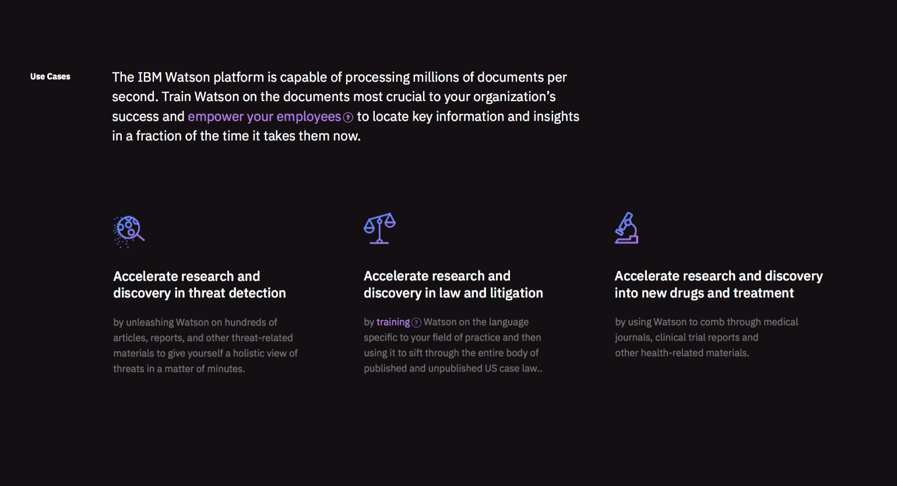
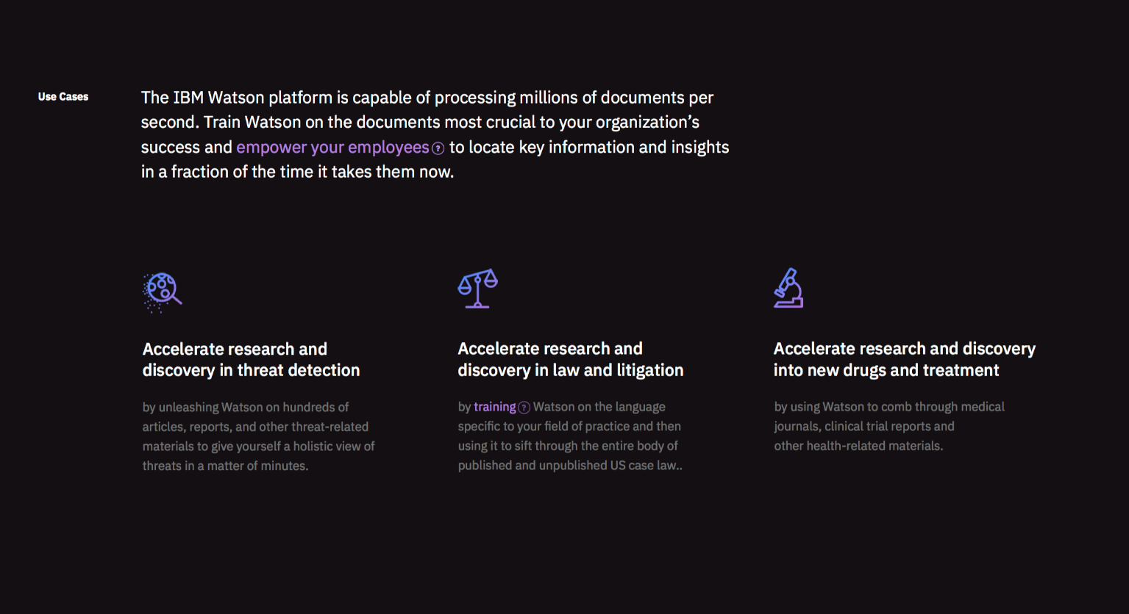




IBM applies domain expertise enabling client innovation in each industry
Deep industry skills
Experience
Applications
Data sets
Partnerships
Innovation labs
+
IBM Cloud
Accelerate digital transformation with Cloud & AI / July 2018 / © 2018 IBM Corporation
12
Notes:
Unlike pure cloud platform vendors, that can offer cloud technology expertise, IBM brings industry expertise and an understanding of your unique business model, workloads, competitors, security and compliance requirements, and other critical business requirements. We have methodologies for modernizing your business that go beyond apps and data, to include processes, skills, integration, and more. We know core business applications like SAP, Vmware, Oracle, and key transactional systems, including those that run on mainframe. To help you create new and innovative experiences, we offer robust data sets and access to more types of data including healthcare, weather, IoT, video Social and more. IBM has partnerships with all major cloud and IT vendors, as well as support for more open standards. And IBM continues to lead in innovation with more patents than all other cloud and technology vendors.

Slide 15

















Industry use cases
Banking
Insurance
Telco
Energy & Utilities
Media & Entertainment
Optimize Offers and Cross Sell
Contact Center Efficiency and Problem Resolution
Payment Fraud Detection & Investigation
Counterparty Credit Risk Management
Claims Fraud
Customer Retention
Catastrophe Modeling
Telematics
Producer Effectiveness
Pro-active Call Center
Network Analytics
Location Based Services
IT/Network Infrastructure Transformation
Smarter Campaigns
Smart Meter Analytics
Distribution Load Forecasting/Scheduling
Condition Based Maintenance
Create & Target Customer Offerings
Business process transformation
Audience & Marketing Optimization
Multi-Channel Enablement
Digital commerce optimization
Retail
Travel & Transport
Consumer Products
Government
Healthcare
Actionable Customer Insight
Merchandise Optimization Playbook
Dynamic Pricing
Customer Analytics & Loyalty Marketing
Capacity & Pricing Optimization
Predictive Maintenance Analytics
Optimized Promotions Effectiveness
Micro-Market Campaign Management
Real Time Demand Forecast
Threat Prediction and Prevention
Health and human services fraud, waste & abuse
Tax compliance - fraud and abuse
Crime prevention and prediction
Measure & Act on Population Health
Engage Consumers in their Healthcare
Automotive
Chemical & Petroleum
Aerospace & Defense
Electronics / Industrial Products
Life Sciences
Data Warehouse Optimization
Predictive Asset Optimization (PAO)
Actionable Customer Intelligence
Connected vehicle
EDW Smart Consolidation & Augmentation
Operational Surveillance, Analysis & Optimization
Engineering & Operational Data Exploration & Mining
Uniform Information Access Platform
Data Warehouse Optimization
Predictive Asset Optimization (PAO)
Channel Driven Customer Analytics (CDCA)
Predictive Asset Optimization (PAO)
Increase visibility into drug safety and effectiveness

Slide 16
Data Science use case #1
Store Revenue Prediction
Mettre tes propres experiences sur les projets menés

Slide 17
Data Science use case #2
Store Revenue Prediction
Mettre tes propres experiences sur les projets menés

Slide 18
Data Science use case #3
Store Revenue Prediction
Mettre tes propres experiences sur les projets menés

Slide 19
Definition of the Data Science
Data Science is
the practice of various scientific fields,
their algorithms, approaches and processes,
through the use of programming languages and software frameworks,
that aims to extract knowledge, insights and recommendations from data,
and deliver them to business users and consumers in consumable applications.
Notes:
This slide provides a textbook definition of Data Science. Please read through the definition.
Part of this definition has been influenced by the entry for Data Science in Wikipedia and other parts by the material presented in the Big Data University – Data Science 101 course. However, this definition as is, in its entirety, represents original content.

Slide 20
Augmented Human Intelligence
Notes:
https://harshityadav95.blogspot.fr/2017/06/difference-between-ai-machine-learning.html
https://www.kdnuggets.com/2016/10/deep-learning-key-terms-explained.html
As shown in the image above, deep learning is to data mining as (deep) neural networks are to machine learning (process versus architecture). Also visible is the fact that deep neural networks are heavily involved in contemporary artificial intelligence, to the point that the 2 are so intertwined as to be bordering on synonymous (they are, however, not the same thing, and artificial intelligence has numerous other algorithms and techniques at its disposal beyond neural networks). Also note the connection between deep learning/deep neural networks and computer vision, natural language processing, and generative models, of particular importance given the great strides made in the recent past in these fields, driven by deep learning processes and neural network technologies.
La vision par ordinateur (aussi appelée vision artificielle ou vision numérique) est une branche de l'intelligence artificielle dont le principal but est de permettre à une machine d'analyser, traiter et comprendre une ou plusieurs images prises par un système d'acquisition (par exemple : caméras, etc.).
In probability and statistics, a generative model is a model for generating all values for a phenomenon, both those that can be observed in the world and "target" variables that can only be computed from those observed. By contrast, discriminative models provide a model only for the target variable(s), generating them by analyzing the observed variables. In simple terms, discriminative models infer outputs based on inputs, while generative models generate both inputs and outputs, typically given some hidden parameters.

Slide 21
Predictive Analytics
Predictive analytics helps connect data to effective action
by drawing reliable conclusions about current conditions
and future events.
— Gareth Herschel, Research Director, Gartner Group
Analytics
Predictive Analytics
Data Mining
Analytics is how an entity (i.e., business) arrives at an optimal or realistic decision based on existing data.
Predictive analytics encompasses a variety of techniques (statistics, data mining) that analyze current and historical facts to make predictions about future events.
Data mining is the process of extracting patterns from data.
Notes:
21

Slide 22
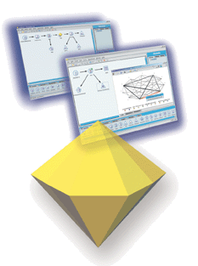
Data Mining
The Data Mining creates patterns by analyzing the data automatically
Patterns that have been found can tell us:
What’s happening
What’s likely to happen
What actions are likely to be effective
Patterns are used to make predictions, like:
Customer likely to churn
Typical high-value customer
High or low credit risk
Suspect transaction
Looks like tumor type B
…
Notes:
22
SPSS Inc.
Copyright 2003-4, SPSS Inc.
22
Whenever I see a definition, I want to say “ok, that’s the definition, but what is it really. If I could see data mining taking place, what would I see?”
Here’s what you’d see: people using predictive algorithms, or we often say data mining algorithms, along with a range of other techniques, and producing two kinds of results.
The first is new knowledge, or we often say insight, about the business issue that we set out to tackle. This can be useful in itself; because we know more, we can act more effectively.
But data mining also produces predictive models; this is important, because these are technology objects which can make predictions about individual cases. They can recognize, for example, the signs of a particular type of customer, or the potential for a certain specific behavior, or something that looks suspicious. And this means that we can use these data mining models to tell us things about our customer base, or our financial data, or our scientific data, which would never have been found by the slower method of applying human expertise.
In other words, data mining models, that is predictive models, can tell us what’s happening, what’s likely to happen, and what actions are likely to be effective, for a volume of data and at a level of detail unmatched by any other technology or human agent.

Slide 23

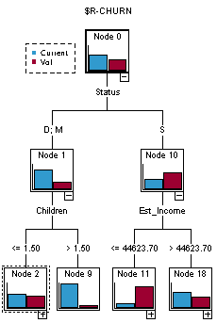
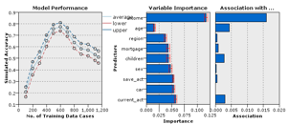
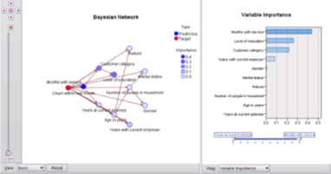
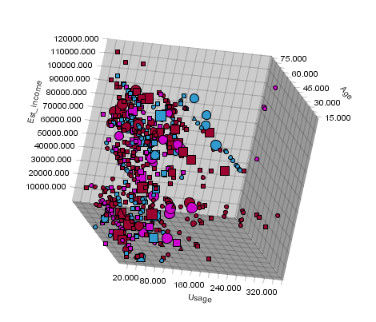
Capabilities for the Data Mining
Data mining requires a range of capabilities:
Comprehensive access to data
Visualization and exploration of data
Data manipulation, cleaning & transformation
Creating and evaluating predictive models
Deployment of results into business processes
Notes:
23
SPSS Inc.
Copyright 2003-4, SPSS Inc.
23
The core technology is data mining algorithms.
But data mining also makes use of other capabilities.
It needs comprehensive access to data.
It needs the ability to explore the data and visualize it, for example creating both simple and complex graphs.
Data mining needs the ability to manipulate the data, to remove errors and to transform the data into the right form for asking questions.
It needs the algorithms for creating predictive models, and the ability to evaluate those models.
And of course it needs the ability to feed these models, and the predictions they make, into business processes, that is to deploy the results.

Slide 24
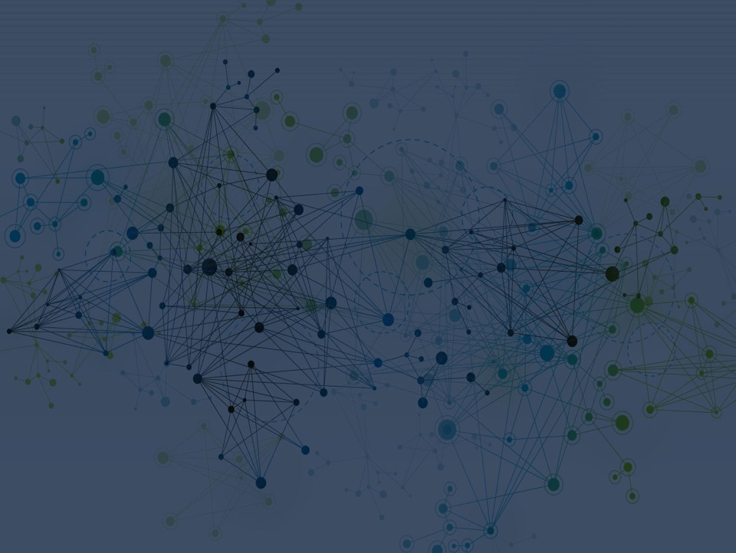
IBM SPSS Modeler

Slide 25
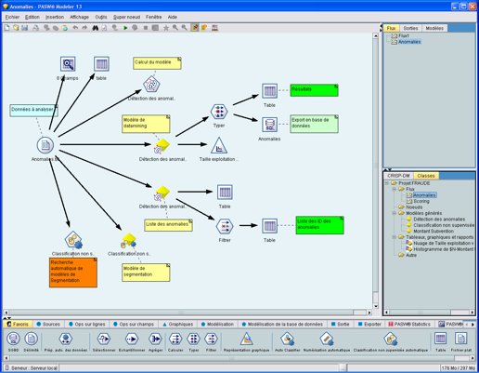
IBM SPSS Modeler
Workbench with data preparation functions to build analytic streams or jobs and a run time environment for job execution.
Set of mining algorithms that provide insight and prediction.
Enables the discovery of key insights, patterns and trends in data that can be used to optimize business decisions.
Notes:
25

Slide 26
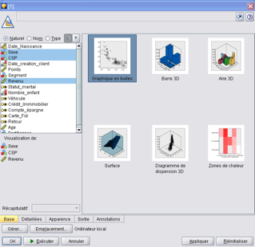
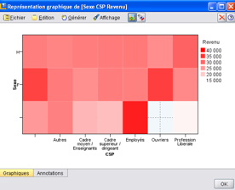
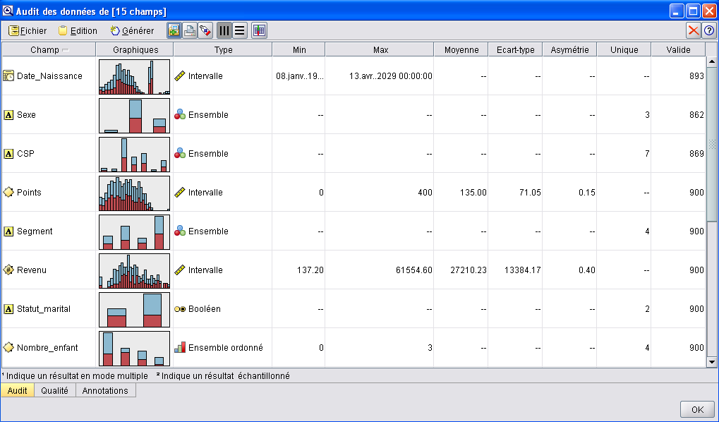
IBM SPSS Modeler
Data access
Data Management
Visualization
Modeling
Deployment
Notes:
SPSS Inc.
Copyright 2006 SPSS Inc.
26

Slide 27
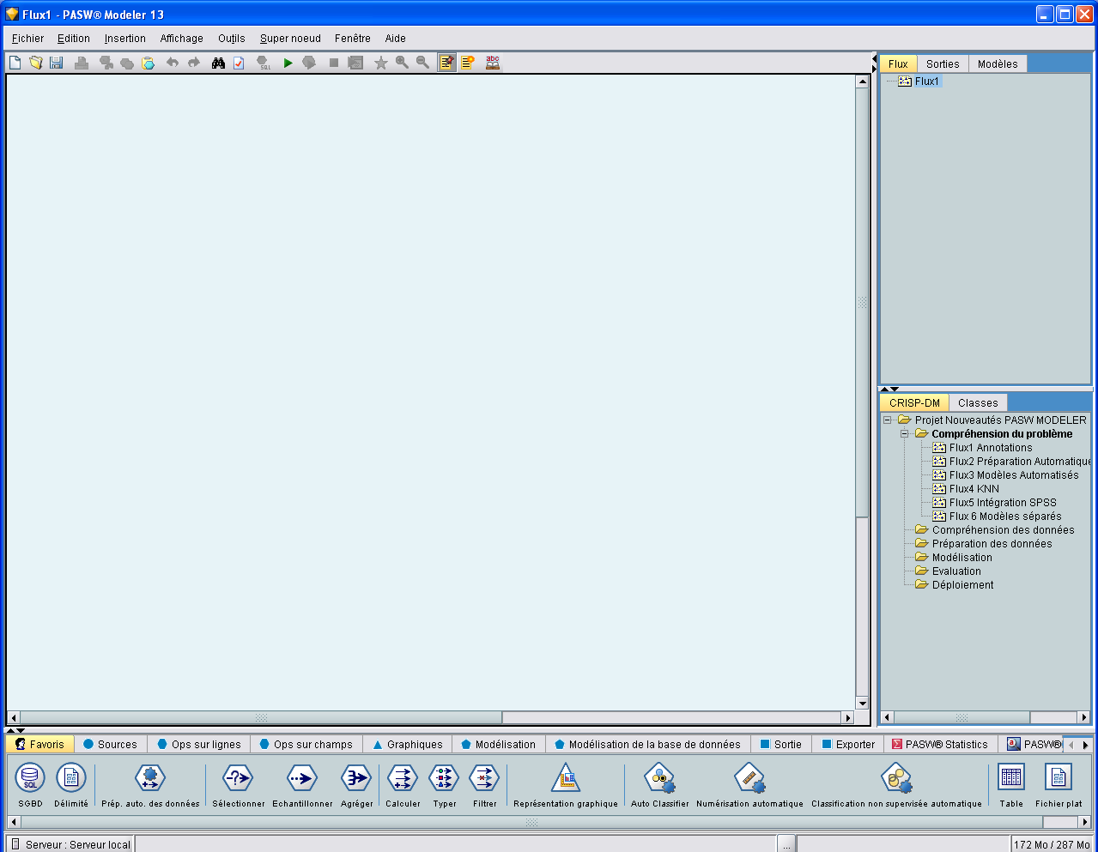
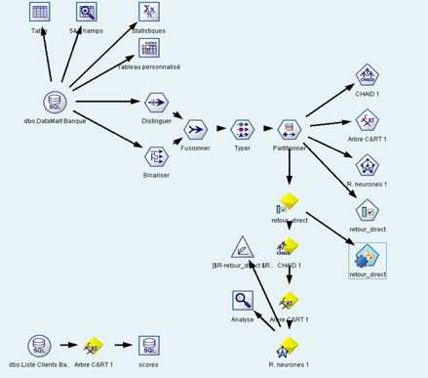
IBM SPSS Modeler : data mining platform
Visualization
Stream, Results, Models
Data access
IBM SPSS Modeler
Modeling
Transformation
Deployment
Project
Evaluate
Nodes

Slide 28

Analytical Techniques in IBM SPSS Modeler
Technique | Algorithms | Usage
Classification (Or Prediction) | Autoclassifiers, Decision Trees, Logistic, Support Vector Machines, Time Series | Predict Group Membership (e.g., Will This Employee Leave?) Or a Number (e.g., How Many Widgets Will I Sell?)
Segmentation | Autoclusters, K-Means, Anomaly Detection | Classify Data Points Into Groups That Are Internally Homogenous and Externally Heterogeneous, Identify Cases That Are Unusual
Association | Apriori, CARMA, Sequence | Find Events That Occur Together Or In a Sequence Market Basket
Geospatial | Space-Time Boxes | Ability to Improve Model Accuracy (for Any Model Type) By Including Inputs Derived From Geospatial Data Sources
Automated | Autoclassified, Autonumeric, Time Series, Clustering | Automatically Find the Right Algorithms Based On Data and Outcome to Create An Ensemble Model
Simulation | Monte Carlo | Run Different Scenarios to Identify Which Is Best From Historical Data Or Generated Data
Specialized | Text Analytics, Entity Analytics, Social Network Analysis | Improve Overall Model Accuracy
In-database | Netezza, DB2, Oracle, Microsoft | Provide User Friendly Interface On Top of Vendor Algorithms
Open Source | R/Spark/Python | Utilize Open Source Algorithms Within Modeler UI. Enhance By Easily Building Custom Dialogs (or downloading from community)
A single analysis project may include multiple techniques
Notes:
Modeler has a very broad range of modeling algorithms, grouped by their usage.
Classification, Segmentation and Association
Classification includes techniques such as decision trees, regression or neural networks and is typically used to predict group membership. For example, will this employee leave? Or to predict a customer value.
Segmentation algorithms are used to put data into groups and predict group membership for new cases. Association finds events that occur together or in a sequence. These techniques are used for market basket analysis where users are looking to see what products are bought together and in what order.
There are also some automated modeling procedures which enable users to quickly generate multiple models and evaluate their performance before selecting which is the most appropriate to use in each case.

Slide 29
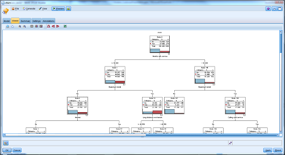
Classification and Prediction
Help to predict a result:
Will a customer buy or leave
Does transaction fit a known pattern of fraud
Expected inventory levels
Forecast number of widget purchases
Techniques included
Decision Trees
Bayesian Networks
Neural Networks
Decision List
Statistical Models
Time Series
Self Learning Response Models
Support Vector Models
Nearest Neighbor Models
Notes:
Classification models use the values of one or more input fields to predict the value of one or more output, or target, fields. Some examples of these techniques are: decision trees (C&R Tree, QUEST, CHAID and C5.0 algorithms), regression (linear, logistic, generalized linear, and Cox regression algorithms), neural networks, support vector machines, and Bayesian networks.
Classification models helps organizations to predict a known result, such as whether a customer will buy or leave or whether a transaction fits a known pattern of fraud. Modeling techniques include machine learning, rule induction, subgroup identification, statistical methods, and multiple model generation.

Slide 30
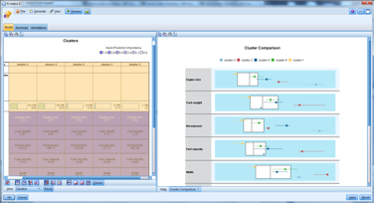
Segmentation
Help to group records into clusters or identify unusual cases:
Identify new patterns of fraud
Identify groups of interest in your customers
Identify data segments that are unusual
Techniques included
Kohonen
K-Means
TwoStep
Notes:
Segmentation models divide the data into segments, or clusters, of records that have similar patterns of input fields. As they are only interested in the input fields, segmentation models have no concept of output or target fields. Examples of segmentation models are Kohonen networks, K-Means clustering, two-step clustering and anomaly detection.
Segmentation models (also known as "clustering models") are useful in cases where the specific result is unknown (for example, when identifying new patterns of fraud, or when identifying groups of interest in your customer base). Clustering models focus on identifying groups of similar records and labeling the records according to the group to which they belong. This is done without the benefit of prior knowledge about the groups and their characteristics, and it distinguishes clustering models from the other modeling techniques in that there is no predefined output or target field for the model to predict. There are no right or wrong answers for these models. Their value is determined by their ability to capture interesting groupings in the data and provide useful descriptions of those groupings. Clustering models are often used to create clusters or segments that are then used as inputs in subsequent analyses (for example, by segmenting potential customers into homogeneous subgroups).

Slide 31
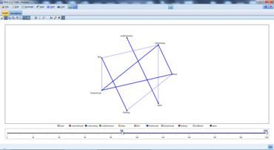
Association
Help determine relationships and rules to determine an outcome given a set of conditions:
Find associations quickly in larger data sets
Customers who bought product X also bought Y and Z (market basket)
Products related to target product promotion
Techniques included
Apriori
CARMA
Sequence Model
Association Rules
Notes:
Association models find patterns in your data where one or more entities (such as events, purchases, or attributes) are associated with one or more other entities. The models construct rule sets that define these relationships. Here the fields within the data can act as both inputs and targets. You could find these associations manually, but association rule algorithms do so much more quickly, and can explore more complex patterns. Apriori and Carma models are examples of the use of such algorithms. One other type of association model is a sequence detection model, which finds sequential patterns in time-structured data.
Association models are most useful when predicting multiple outcomes—for example, customers who bought product X also bought Y and Z. Association models associate a particular conclusion (such as the decision to buy something) with a set of conditions. The advantage of association rule algorithms over the more standard decision tree algorithms (C5.0 and C&RT) is that associations can exist between any of the attributes. A decision tree algorithm will build rules with only a single conclusion, whereas association algorithms attempt to find many rules, each of which may have a different conclusion.

Slide 32
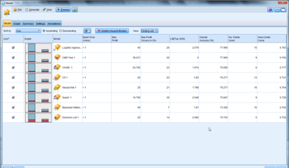



Automated Modeling
Choose from three automated modeling nodes, depending on the needs of your analysis
Build a number of different modeling methods in a single modeling run, then rank them to compare the models’ performance.
Techniques included
Auto Classifier
Auto Numeric
Auto Cluster
Notes:
The Auto Classifier node creates and compares a number of different models for binary outcomes (yes or no, churn or do not churn, and so on), allowing you to choose the best approach for a given analysis. A number of modeling algorithms are supported, making it possible to select the methods you want to use, the specific options for each, and the criteria for comparing the results. The node generates a set of models based on the specified options and ranks the best candidates according to the criteria you specify.
The Auto Numeric node estimates and compares models for continuous numeric range outcomes using a number of different methods. The node works in the same manner as the Auto Classifier node, allowing you to choose the algorithms to use and to experiment with multiple combinations of options in a single modeling pass. Supported algorithms include neural networks, C&R Tree, CHAID, linear regression, generalized linear regression, and support vector machines (SVM). Models can be compared based on correlation, relative error, or number of variables used.
The Auto Cluster node estimates and compares clustering models, which identify groups of records that have similar characteristics. The node works in the same manner as other automated modeling nodes, allowing you to experiment with multiple combinations of options in a single modeling pass. Models can be compared using basic measures with which to attempt to filter and rank the usefulness of the cluster models, and provide a measure based on the importance of particular fields.
The best models are saved in a single composite model nugget, enabling you to browse and compare them, and to choose which models to use in scoring.

Slide 33

Predict: Developing a Predictive Model
Historical
Data
Training
Set
Validation
Set
Y
Y
?
N
N
?
Y
Y
?
Training
Process
Scoring
Process
Model
Y
Y
N
Y
Y
Y
Algorithm

Slide 34
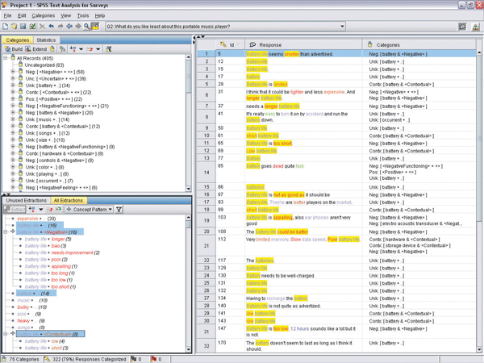
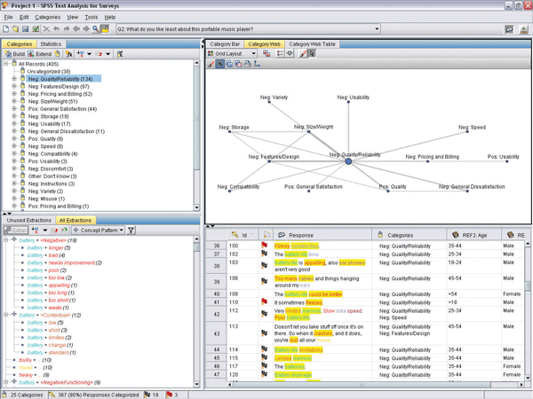
IBM SPSS Text Analytics
Uses natural language processing heuristic rules and statistical techniques to reveal conceptual meaning in text.
Extracts concepts from text and categorizes them.
Makes unstructured qualitative data more quantifiable, enabling the discovery of key insights from sources such as survey responses, documents, emails, call center notes, web pages, blogs, forums and more.
Notes:
34

Slide 35

Text Analysis: Concepts to Attributes
Formulars
Responses for Patient 1234
Data Fields
Open Ends
Structured Data Preparation
Text Mining Process
Concepts
Net Speed = 3GB
Relatives = 13
Emails/day = 20
Concept1= T
Concept2 = T
Concept3 = F
Concept4 = T
Customer =1234
Training Process
Algorithm
Model

Slide 36
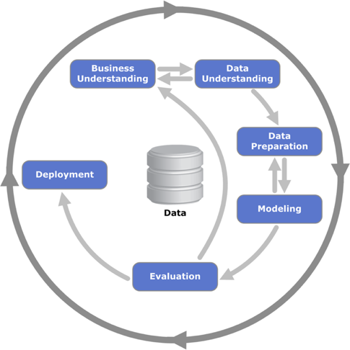
The Data Science methodology consisted to cover the following steps
A known Data Science methodology (Cross Industry Standard Process for Data Mining)
Criteria of success (Business, Technical, Change Management, …)
A collaborative work between the CUSTOMER and the Data Science Expert Team, which secures the success
A Data Science platform

Slide 37

Demonstration

Slide 38
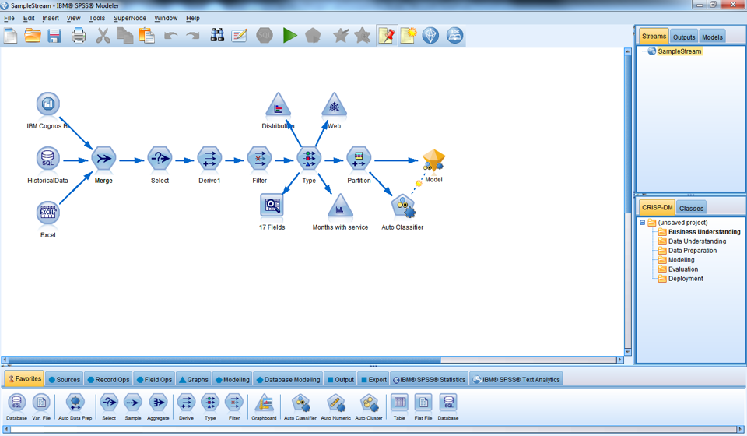
IBM SPSS Modeler User Interface
Notes:
Just before we get Into the demonstration, I would like to step through what Modeler looks like.
You will notice it is visual in nature, so doesn’t require the programming that some other data mining applications do.

Slide 39
IBM SPSS Modeler User Interface – Nodes Palette
Notes:
Most of the data and modeling tools in IBM SPSS Modeler reside in the Nodes Palette, across the bottom of the window below the stream canvas.
For example, the Record Ops palette tab contains nodes that you can use to perform operations on the data records, such as selecting, merging, and appending.
Each palette tab contains a collection of related nodes used for different phases of stream operations, such as:
• Sources. Nodes bring data into SPSS Modeler.
• Record Ops. Nodes perform operations on data records, such as selecting, merging, and appending.
• Field Ops. Nodes perform operations on data fields, such as filtering, deriving new fields, and determining the measurement level for given fields.
• Graphs. Nodes graphically display data before and after modeling. Graphs include plots, histograms, web nodes, and evaluation charts.
• Modeling. Nodes use the modeling algorithms available in SPSS Modeler, such as neural nets, decision trees, clustering algorithms, and data sequencing.
• Database Modeling. Nodes use the modeling algorithms available in Microsoft SQL Server, IBM DB2, and Oracle databases.
• Output. Nodes produce a variety of output for data, charts, and model results that can be viewed in SPSS Modeler.
• Export. Nodes produce a variety of output that can be viewed in external applications, such as IBM SPSS Data Collection or Excel.
• SPSS Statistics. Nodes import data from, or export data to, IBM SPSS Statistics, as well as running SPSS Statistics procedures.
To add nodes to the canvas, double-click icons from the Nodes Palette or drag and drop them onto the canvas. You then connect them to create a stream, representing the flow of data.

Slide 40
IBM SPSS Modeler User Interface – Stream Canvas
Notes:
Once the nodes are added to the canvas and connected, they form a stream which describes the process that will be executed allowing the data to flow through it and making it easy for someone else to see what is happening.
In this example data is being merged from 3 sources, then a subset is taken, a new field is created, some data exploration is taking place, then a model is being built.

Slide 41
IBM SPSS Modeler User Interface – Managers Pane & Project Pane
Notes:
At the top right of the window is the managers pane. This has three tabs, which are used to manage streams, output and models.
You can use the Streams tab to open, rename, save, and delete the streams created in a session.
The Outputs tab contains a variety of files, such as graphs and tables, produced by stream operations in IBM SPSS Modeler. You can display, save, rename, and close the tables, graphs, and reports listed on this tab.
The Models tab is the most powerful of the manager tabs. This tab contains all model nuggets, which contain the models generated in SPSS Modeler, for the current session. These models can be browsed directly from the Models tab or added to the stream in the canvas.
On the lower right side of the window is the project pane, used to create and manage data mining projects (groups of files related to a data mining task). There are two ways to view projects you create in IBM SPSS Modeler—in the Classes view and the CRISP-DM view.
The CRISP-DM tab provides a way to organize projects according to the Cross-Industry Standard Process for Data Mining, an industry-proven, nonproprietary methodology. For both experienced and first-time data miners, using the CRISP-DM tool will help you to better organize and communicate your efforts.
The Classes tab provides a way to organize your work in SPSS Modeler categorically—by the types of objects you create. This view is useful when taking inventory of data, streams, and models.

Slide 42
IBM SPSS on the Cloud, and extended offerings

Slide 43
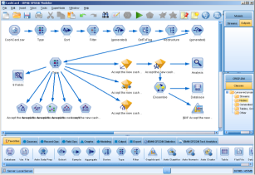
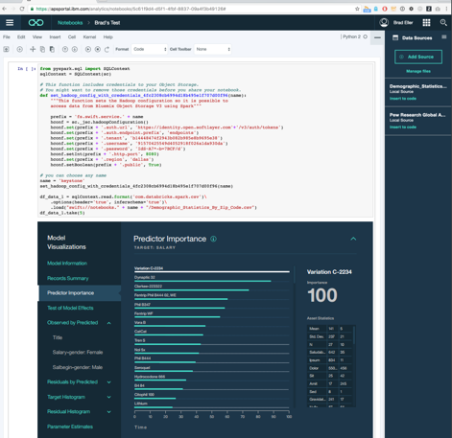
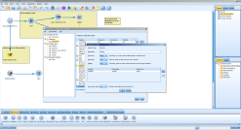
IBM SPSS and the cloud
Powerful workbench for code-optional predictive analytics
SPSS Algorithms in Python, R and Scala and Interactive Model Visualization through IBM Watson Studio
Delivered in the cloud through IBM Watson Studio (SPSS)
Notes:
IBM SPSS and Data Science Experience are being brought together to offer a true one stop shop for data science that has the best of both worlds
Visual model creation, training and evaluation through IBM SPSS and the flexibility of open source – being able to use SPSS algorithms in R, Python and Scala
And it’s within the collaborative, social environment built by data scientists – for data scientists

Slide 45
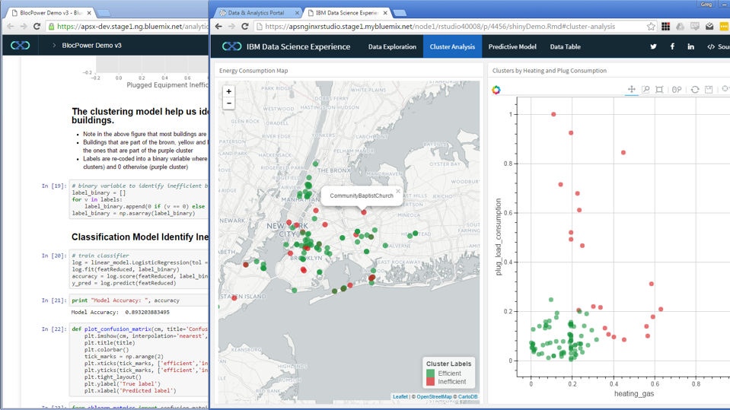
Interactively explore the analysis of your data science team
Notes:
After the initial data exploration, we move to cluster analysis. Here we cluster the building by heating and plug consumption to find efficient and inefficient buildings. The efficient buildings are colored green and the inefficient are colored red. We are also displaying these efficient and inefficient buildings on a map to enable us to visually drilldown on where they are located and look for commonalities.

Slide 46
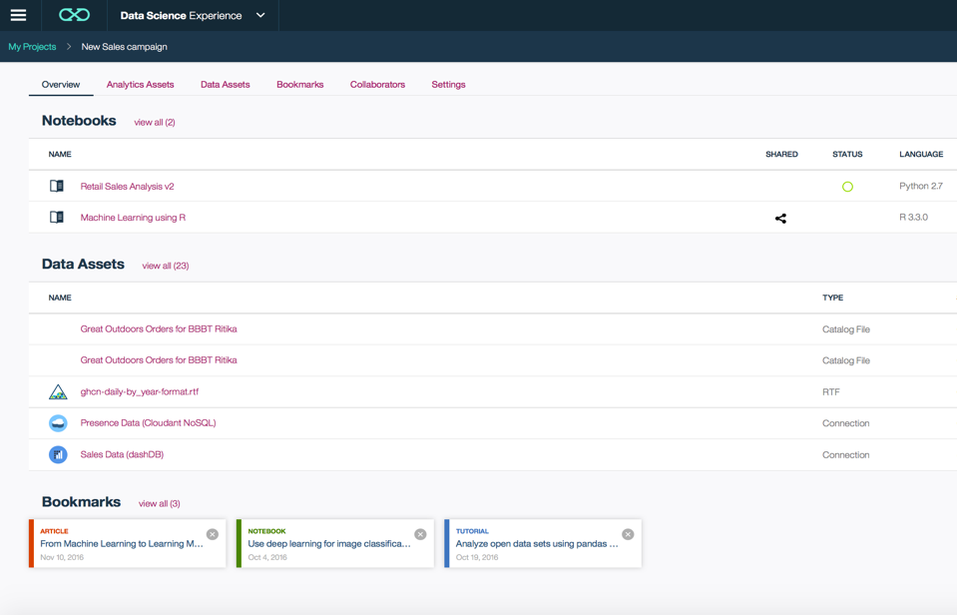
Collaborate Using Projects
Notes:
Projects are a core component of our Watson Data Platform. Projects make collaboration easier – they are a collaborative entity with data services, connections, object storage, notebooks and more. Once you create a new project within Data Science Experience, you are presented with an interface like the one shown in the slide, it is a project management framework where you can view/create/add/modify/remove various assets. A framework like this can play a huge role in bringing down siloes across the various data personas and promote collaboration.

Slide 47


IBM SPSS and IBM Watson Studio… better together
Auto data preparation
Auto data modeling
Visual exploration of analysis
Interactive coding
Innovative visualization
Experimentation
No downloads
IBM SPSS Modeler
ibm.com/spss
Watson Studio
Notes:
At the end of the day, what you see is that these two product are better together
In IBM SPSS Modeler, time saving features like auto data prep and auto data modeling and the ability to visualize models interactively – with all of the relevant statistics explained and in context – gives the data science professional a quick way to get started
With IBM Data Science Experience – you have a community, a coding platform, and a place to experiment and develop your skills while working on analytical projects
You can start with either one and move to the other – it all depends on what you are doing. If you or your prospects/ customers want to know more about the integration between SPSS and DSX then it is highly recommended to watch this external webinar (you can find the link to this below). You can also share this with your customers, BPs etc.
Link to the webinar.
http://www.eweek.com/ebooks/224662510/95900/1613990/224664?qset=CONTEXT_STEP1&mcss=y&CCID=20367793204611971&QTR=ZZf201608160825320Za20367793Zg172Zw47Zm623Zc204611971Zs20878ZZ&CLK=989160916080007312&&exp=y

Slide 48
Thank You
Yann Gouedo
Data Scientist Leader – Machine Learning / Artificial Intelligence
Marketing / Risk / Fraud / Maintenance
IBM Certified Senior Data Scientist & IBM Certified Senior Architect

